Slide 1
Exam Preparation & Building a Computer
Exam Preparation, Multiplication Implementation Exercise, Building a Computer, Hack CPU Interface

Slide 2
Lecture Outline
Exam Preparation
Study Strategies, Mock Exam Problem
Multiplication Implementation Exercise
Multiplying Two Numbers in Hack Assembly
Building a Computer
Architecture, Fetch and Execute Cycle
Hack CPU Interface
Implementation and Operations

Slide 3
Exams Preparation Discussion
What are some exam preparation strategies that you have found helpful?
What is one thing that is effective and ineffective about the way you study? Why?
How might you implement some of these effective strategies for change your exam preparation strategy for this quarter?

Slide 4
Gearing Up For Exams
Make a Study Plan
What key topics / concepts does your exam cover?
How might your study guides look different for specific classes?
What resources, materials, or people might you engage with?
Create a Schedule
Avoid cramming
Office hours, review sessions, study groups
Reference your weekly time commitments & quarterly calendar
Test Yourself
What are ways that you can test yourself?
Replicate exam-like environments

Slide 5
Project 6, Part I: Mock Exam Problem
Schedule a 30-minute session based on your group members' availability to complete one mock exam problem
Determine how you will connect with each other and where your session will be located
Mock exam problem groups:
Please have one person from your group email Eric when you will meet for the mock exam problem by 4/27
Group Number | Group Members
Group 1 | Guadalupe, Rodas, Vicky
Group 2 | Delano, Richard
Group 3 | Tai, Yohannes, David
Group 4 | Nathaniel, Simon
Group 5 | Benito, Ty
Group 6 | Deya, Elainie
Group 7 | Alex, Matthew, Said
Group 8 | Kris, Binh

Slide 6
Lecture Outline
Exam Preparation
Study Strategies, Mock Exam Problem
Multiplication Implementation Exercise
Multiplying Two Numbers in Hack Assembly
Building a Computer
Architecture, Fetch and Execute Cycle
Hack CPU Interface
Implementation and Operations

Slide 7
Review: What is Binary?
A base-n number system is a system of number representation with n symbols
Decimal system is a base-10 number system
Base-10 symbols: 0, 1, 2, 3, 4, 5, 6, 7, 8, 9
Increase a number by moving to the next greatest symbol
Add another digit when we run out of symbols
Binary is a base-2 number system
Often prefixed with 0b (e.g., 0b1101, 0b10)
Base-2 symbols: 0, 1

Slide 8
Hexadecimal
Base-16 number system
Symbols: 0, 1, 2, 3, 4, 5, 6, 7, 8, 9, A, B, C, D, E, F
Commonly used for referring to memory addresses
Simple to convert between binary and hexadecimal
Hexadecimal uses fewer digits to represent a value than binary
Uses the prefix 0x to indicate a number is written in hexadecimal
32 is decimal, 0x32 is hexadecimal

Slide 9
Number Representation Comparison
Decimal | Hexadecimal | Binary
0 | 0x0 | 0b0000
1 | 0x1 | 0b0001
2 | 0x2 | 0b0010
3 | 0x3 | 0b0011
4 | 0x4 | 0b0100
5 | 0x5 | 0b0101
6 | 0x6 | 0b0110
7 | 0x7 | 0b0111
8 | 0x8 | 0b1000
9 | 0x9 | 0b1001
10 | 0xA | 0b1010
11 | 0xB | 0b1011
12 | 0xC | 0b1100
13 | 0xD | 0b1101
14 | 0xE | 0b1110
15 | 0xF | 0b1111

Slide 10
Binary and Hexadecimal Conversion
One-to-one correspondence between binary and hexadecimal
To convert from binary to hexadecimal, swap out binary bits digits for the corresponding hexadecimal digit (or vice versa)
Example: 0x3A is 0b0011_1010
0x3 == 0b0011
0xA == 0b1010

Slide 11
Exercise: Implementing Multiplication
Write a program that multiplies R0 and R1 and stores the result in R2
Remember we don’t have a multiply operation
We will have to use add and loops to get the job done
Roadmap
Start with pseudocode using if statements, loops, etc.
Remove conditionals and loops by using jumps in pseudocode
Convert pseudocode to assembly

Slide 12
Exercise: Implementing Multiplication
Goal: Implement R0 × R1 = R2
Pseudocode | Hack Assembly

Slide 13
Exercise: Implementing Multiplication
Goal: Implement R0 × R1 = R2
Pseudocode | Hack Assembly
Approach: add R0 to the result R1 times
Notes:
Have students write out the pseudocode

Slide 14
Exercise: Implementing Multiplication
Goal: Implement R0 × R1 = R2
Pseudocode | Hack Assembly
Approach: add R0 to the result R1 times
R2 = 0
while (R1 > 0) {
R2 = R0 + R2
R1 = R1 - 1
}

Slide 15
Exercise: Implementing Multiplication
Remove loops from pseudocode
Use labels to notate important sections of the code
Attempt 1: What happens when R1 is 0? What should happen?
START:
R2 = 0
LOOP:
R2 = R0 + R2
R1 = R1 - 1
IF R1 > 0 JMP LOOP
END:
INFINITE LOOP
R2 = 0
while (R1 > 0) {
R2 = R0 + R2
R1 = R1 - 1
}
Notes:
What’s the problem with this? Will always execute the first two lines in loop at the beginning

Slide 16
Exercise: Implementing Multiplication
Remove loops from pseudocode
Use labels to notate important sections of the code
Attempt 1: What happens when R1 is 0? What should happen?
START:
R2 = 0
LOOP:
IF R1 <= 0
JMP to END
R2 = R0 + R2
R1 = R1 - 1
JMP LOOP
END:
INFINITE LOOP
R2 = 0
while (R1 > 0) {
R2 = R0 + R2
R1 = R1 - 1
}

Slide 17
Exercise: Implementing Multiplication
Convert to Hack Assembly
Memory (M):
5 | 2
R0 | R1 | R2
START:
R2 = 0
LOOP:
IF R1 <= 0
JMP to END
R2 = R0 + R2
R1 = R1 - 1
JMP LOOP
END:
INFINITE LOOP
Registers:
D | A
(START)
@R2
M = 0
(LOOP)
(END)

Slide 18
Exercise: Implementing Multiplication
Convert to Hack Assembly
Memory (M):
5 | 2
R0 | R1 | R2
START:
R2 = 0
LOOP:
IF R1 <= 0
JMP to END
R2 = R0 + R2
R1 = R1 - 1
JMP LOOP
END:
INFINITE LOOP
(START)
@R2
M = 0
(LOOP)
@R1
D = M
@END
D; JLE
(END)
Registers:
D | A

Slide 19
Exercise: Implementing Multiplication
Convert to Hack Assembly
(START)
@R2
M = 0
(LOOP)
@R1
D = M
@END
D; JLE
@R0
D = M
@R2
M = M + D
(END)
Memory (M):
5 | 2
R0 | R1 | R2
START:
R2 = 0
LOOP:
IF R1 <= 0
JMP to END
R2 = R0 + R2
R1 = R1 - 1
JMP LOOP
END:
INFINITE LOOP
Registers:
D | A

Slide 20
Exercise: Implementing Multiplication
(START)
@R2
M = 0
(LOOP)
@R1
D = M
@END
D; JLE
@R0
D = M
@R2
M = M + D
@R1
M = M - 1
@LOOP
0; JMP
(END)
Convert to Hack Assembly
Memory (M):
5 | 2
R0 | R1 | R2
START:
R2 = 0
LOOP:
IF R1 <= 0
JMP to END
R2 = R0 + R2
R1 = R1 - 1
JMP LOOP
END:
INFINITE LOOP
Registers:
D | A

Slide 21
Exercise: Implementing Multiplication
(START)
@R2
M = 0
(LOOP)
@R1
D = M
@END
D; JLE
@R0
D = M
@R2
M = M + D
@R1
M = M - 1
@LOOP
0; JMP
(END)
Convert to Hack Assembly
Memory (M):
5 | 2
R0 | R1 | R2
START:
R2 = 0
LOOP:
IF R1 <= 0
JMP to END
R2 = R0 + R2
R1 = R1 - 1
JMP LOOP
END:
INFINITE LOOP
Registers:
D | A

Slide 22
Exercise: Implementing Multiplication
Convert to Hack Assembly
(START)
@R2
M = 0
(LOOP)
@R1
D = M
@END
D; JLE
@R0
D = M
@R2
M = M + D
@R1
M = M – 1
@LOOP
0; JMP
(END)
@END
0; JMP
Memory (M):
5 | 2
R0 | R1 | R2
START:
R2 = 0
LOOP:
IF R1 <= 0
JMP to END
R2 = R0 + R2
R1 = R1 - 1
JMP LOOP
END:
INFINITE LOOP
Registers:
D | A
Notes:
Walk through an example at the end
Test with R0 = 5, R1 = 2

Slide 23
Lecture Outline
Exam Preparation
Study Strategies, Mock Exam Problem
Multiplication Implementation Exercise
Multiplying Two Numbers in Hack Assembly
Building a Computer
Architecture, Fetch and Execute Cycle
Hack CPU Interface
Implementation and Operations

Slide 24
Building a Computer
All your hardware efforts are about to pay off!
Perspective: BUILDING A COMPUTER
In Project 6, you will build Computer.hdl, the final, top-level chip in this course
For all intents and purposes, a real computer
Simplified, but organization very similar to your laptop
Project 7 onward, we will write software to make it useful

Slide 25

Von Neumann Architecture
COMPUTER
MEMORY
CPU
0
1
2
0101110011100110
1011000101010100
1110001011111100
...
Instructions
INPUT
OUTPUT
n
n+1
n+2
1100101010010101
1100100101100111
0011001010101011
...
Data
REGISTERS
CONTROL

Slide 26
Connecting the Computer: Buses
COMPUTER
MEMORY
CPU
0
1
2
0101110011100110
1011000101010100
1110001011111100
...
Instructions
INPUT
OUTPUT
n
n+1
n+2
1100101010010101
1100100101100111
0011001010101011
...
Data
REGISTERS
CONTROL
Control Bus
Address Bus
Data Bus
Notes:
Control: Instructions, program counter, ALU output control bits (determine whether you should jump or not)
Address: A register communicates which item in item in memory to access, output of control is an address that tells us which instruction to execute
Question: Why two arrows for the address bus?
Data: D register that feeds into the ALU, the output of the ALU may be stored in the D register, to update data in memory

Slide 27
Basic CPU Loop
Repeat forever:
Fetch an instruction from the program memory
Execute that instruction

Slide 28
Fetching
Specify which instruction to read as the address input to our memory
Data output: actual bits of the instruction
MEMORY
Memory Output: Data
Instruction
D=A;JMP
0
1
2
0101110011100110
1011000101010100
1110001011111100
...
Instructions
n
n+1
n+2
1100101010010101
1100100101100111
0011001010101011
...
Data
Memory Input: Address
Instruction Address
PC
1

Slide 29
Executing
The instruction bits describe exactly “what to do”
A-instruction or C-instruction?
Which operation for the ALU?
What memory address to read? To write?
If I should jump after this instruction, and where?
Executing the instruction involves data of some kind
Accessing registers
Accessing memory

Slide 30
Combining Fetch & Execute
MEMORY
Memory Output: Data
Instruction
D=M;JMP
0
1
2
0101110011100110
1011000101010100
1110001011111100
...
Instructions
Data
245
n
n+1
n+2
1100101010010101
1100100101100111
0011001010101011
...
Data
Memory Input: Address
Instruction Address
PC
1
Data Address (From instruction or register)

Slide 31
Combining Fetch & Execute
MEMORY
Memory Output: Data
Could we implement with RAM16K.hdl?
(Hint: Think about the I/O of RAM)
Instruction
D=M;JMP
0
1
2
0101110011100110
1011000101010100
1110001011111100
...
Instructions
Data
245
n
n+1
n+2
1100101010010101
1100100101100111
0011001010101011
...
Data
Memory Input: Address
Instruction Address
PC
1
Data Address (From instruction or register)

Slide 32
Combining Fetch & Execute
MEMORY
Memory Output: Data
Could we implement with RAM16K.hdl?
No! Our memory chips only have one input and one output
Instruction
D=M;JMP
0
1
2
0101110011100110
1011000101010100
1110001011111100
...
Instructions
Data
245
n
n+1
n+2
1100101010010101
1100100101100111
0011001010101011
...
Data
Memory Input: Address
Instruction Address
PC
1
Data Address (From instruction or register)

Slide 33
Solution 1: Handling Single Input / Output
Memory Output: Data
Instruction, when fetching
Can use multiplexing to share a single input or output
MEMORY
0
1
2
0101110011100110
1011000101010100
1110001011111100
...
Instructions
DMux
Data, when executing
n
n+1
n+2
1100101010010101
1100100101100111
0011001010101011
...
Data
Memory Input: Address
Instruction Address
Mux
Data Address
Fetching vs. Executing

Slide 34
Solution 1: Fetching / Executing Separately
Fetching vs. Executing
Memory Output: Data
Instruction, when fetching
Need to store fetched instruction so it’s available during execution phase
MEMORY
Register
0
1
2
0101110011100110
1011000101010100
1110001011111100
...
Instructions
DMux
Data, when executing
n
n+1
n+2
1100101010010101
1100100101100111
0011001010101011
...
Data
Memory Input: Address
Instruction Address
Mux
Data Address
Fetching vs. Executing

Slide 35
Solution 2: Separate Memory Units
Separate instruction memory and data memory into two different chips
Each can be independently addressed, read from, written to
Pros:
Simpler to implement
Cons:
Fixed size of each partition, rather than flexible storage
Two chips → redundant circuitry

Slide 36
Lecture Outline
Exam Preparation
Study Strategies, Mock Exam Problem
Multiplication Implementation Exercise
Multiplying Two Numbers in Hack Assembly
Building a Computer
Architecture, Fetch and Execute Cycle
Hack CPU Interface
Implementation and Operations

Slide 37
Hack CPU
COMPUTER
ROM
(Instructions)
CPU
RAM
(Data)
instr
data out
0
1
2
010111001110
101100010101
111000101111
...
Instructions
0
1
2
100110010111
100011001111
000000000010
...
Data
addr of next instruction
REGISTERS
data in
CONTROL
INPUT
OUTPUT

Slide 38
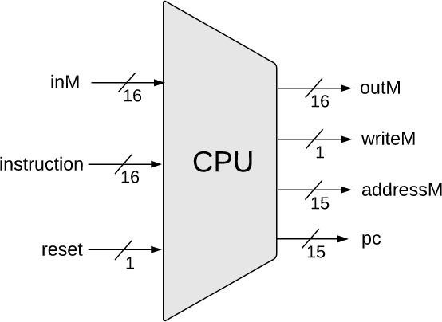
Hack CPU Interface Inputs
inM: Value coming from memory
instruction: 16-bit instruction
reset: if 1, reset the program

Slide 39
Hack CPU Interface Outputs
outM: value used to update memory if writeM is 1
writeM: if 1, update value in memory at addressM with outM
addressM: address to read from or write to in memory
pc: address of next instruction to be fetched from memory
Notes:
Why is addressM only 15 bits? Because updating the A register, which can only store 15 bits for the value itself
Why is pc only 15 bits?
I thought we were using 16-bit words

Slide 40
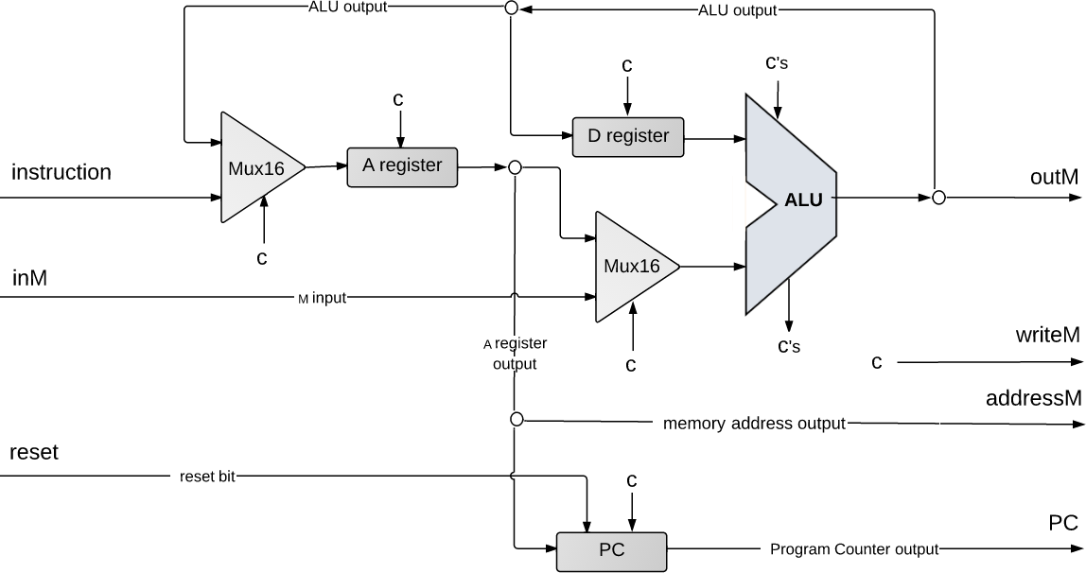
Hack CPU Implementation
Diving beneath the hood… next lecture!
pc

Slide 41
Post-Lecture 9 Reminders
Project 5 due this Thursday (4/27) at 11:59pm
Midterm exam coming up on 5/4 during lecture time
Preston has office hours after class in CSE2 152
Feel free to post your questions on the Ed board as well

